Slide 1



Credit Card Churn Prediction
Faridat Lawal
NYIT

Slide 2


Overview
Objective
Dataset
Data Preprocessing
EDA
Model Evaluation
Final Results
Conclusion/ Modifications
Future Works

Slide 3
Objective
The objective/goal of this project is to predict whether a credit card customer is likely to stay as an existing customer or churn i.e. leave the credit card services. This will be determined based on input features with the use of supervised learning models. Data mining tasks will include cleaning the provided dataset and preparing it for various model evaluations such as Decision Tree, Naive Bayes, K-NN, and Support Vector Machine.

Slide 4
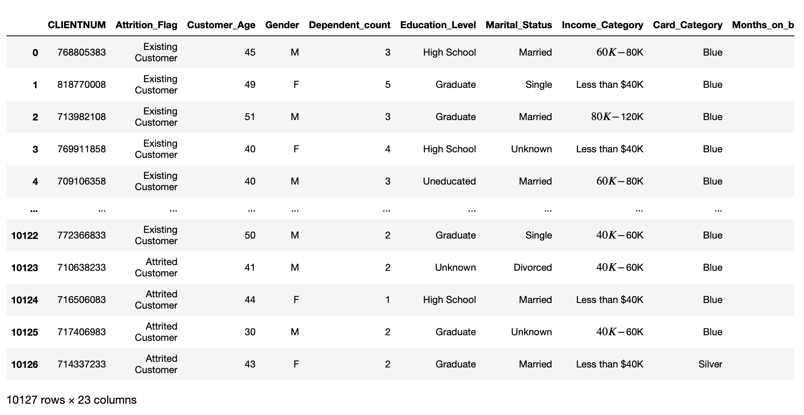
Data Set
The Credit Card customer dataset was found on Kaggle. It contains 10,127 rows and 23 columns. Based off of the snapshot provided it can be seen that we have 6 categorical variables and 17 numerical attributes. Our target feature is Attrition_Flag where the outcome is either Existing or Attrited Customer.

Slide 5
Data Preprocessing
Before model evaluations can begin, there are a few things needed in order to prepare the dataset.

Slide 6
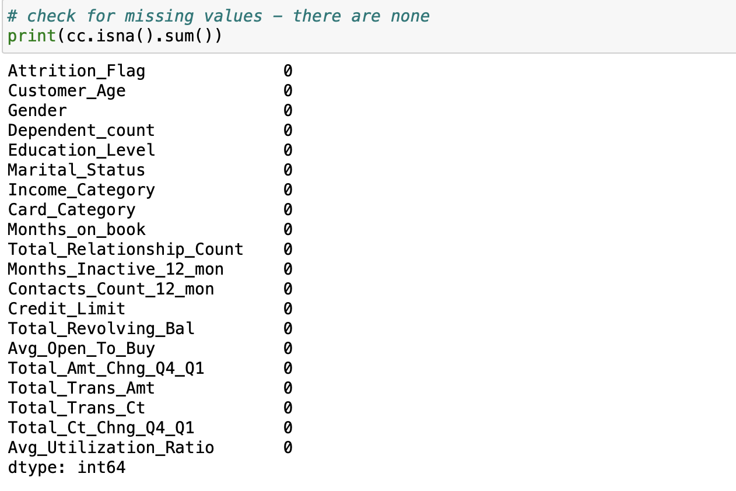
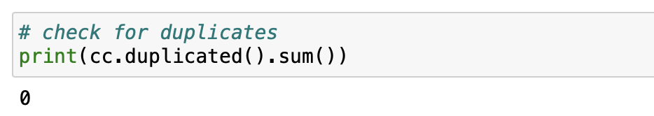
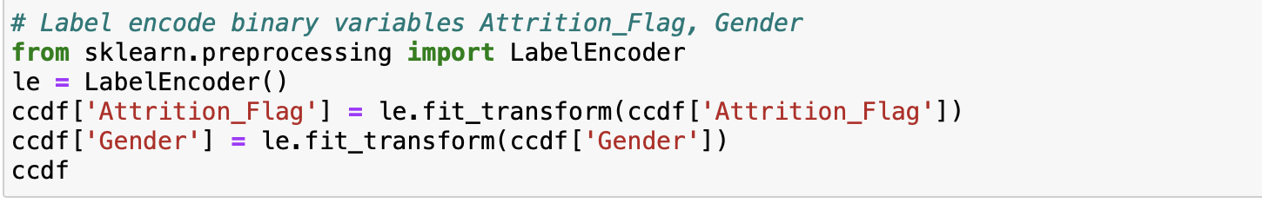
Dataset was checked for missing and duplicate values
Irrelevant columns/rows that would have no impact on predictions were removed
Binary categorical features were label encoded
Dummy variables were created for non-binary categorical features

Slide 7
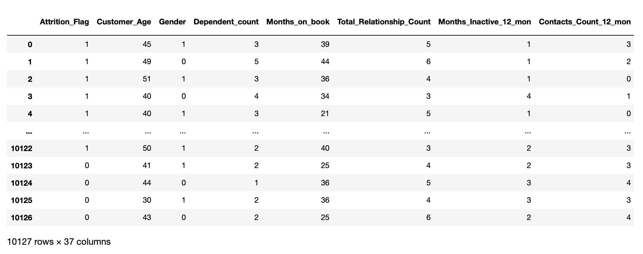
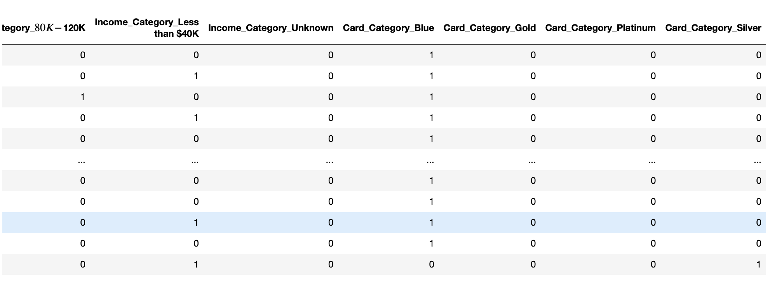
After preprocessing, the shape of the final dataset is 10,127 rows and 37 columns.
What's in
store for us?
Future of Technology
Next generation holographic communication will soon change the way we work and conduct meetings in the workplace, significantly unifying geographically dispersed employees.
With 3D holographic avatars and images, offices can significantly reduce the cost of transporting employees in one place, minimizing airspace travel hazards on the environment.

Slide 8
Exploratory Data Analysis
Correlation Graphs, Pie Charts, Histograms and Plots to explore and visualize the relationships between the features.

Slide 9
Correlation Map
Small positive correlation between Age and Months_Inactive, Total_Revolving_Bal, Avg Utilization Ratio
Medium positive correlation between Age and Months_on_book
Medium Negative correlation between Avg Utilization Ratio and Credit Limit, Avg Open To Buy

Slide 10
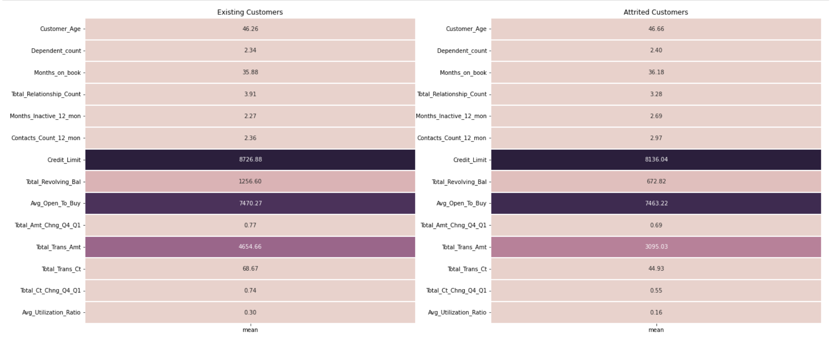
Contd.
Here is another form of a heatmap that calculates the mean value of each numeric feature. Credit Limit, Total Revolving Balance, and Total Transaction Amount have the largest difference of means between Existing and Attrited customers. These features indicate importance and may aid in the prediction of whether a customer will churn or not.

Slide 11
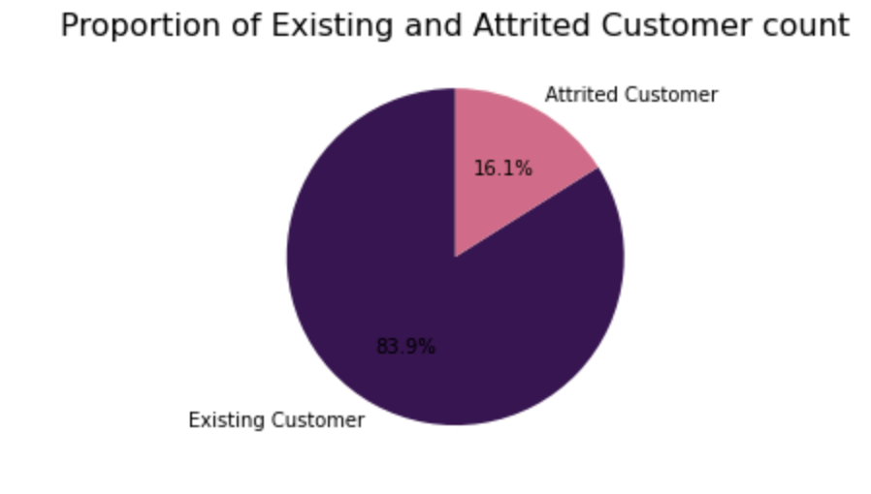
Pie Chart
Based on this pie chart, we can see that our data is not equally balanced. There are more Existing customers (people who stay with the credit card company) than there are Attrited customers (people who leave the credit card company).

Slide 12
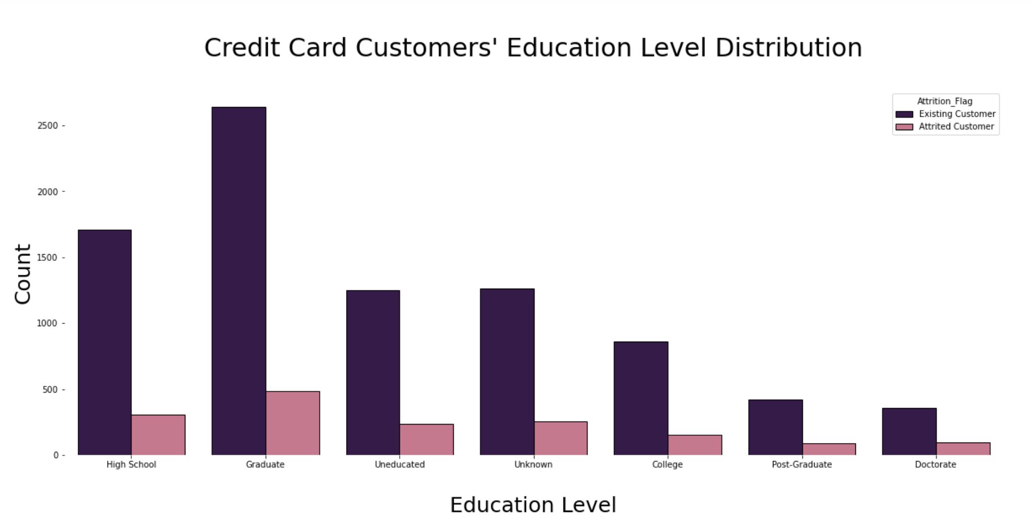
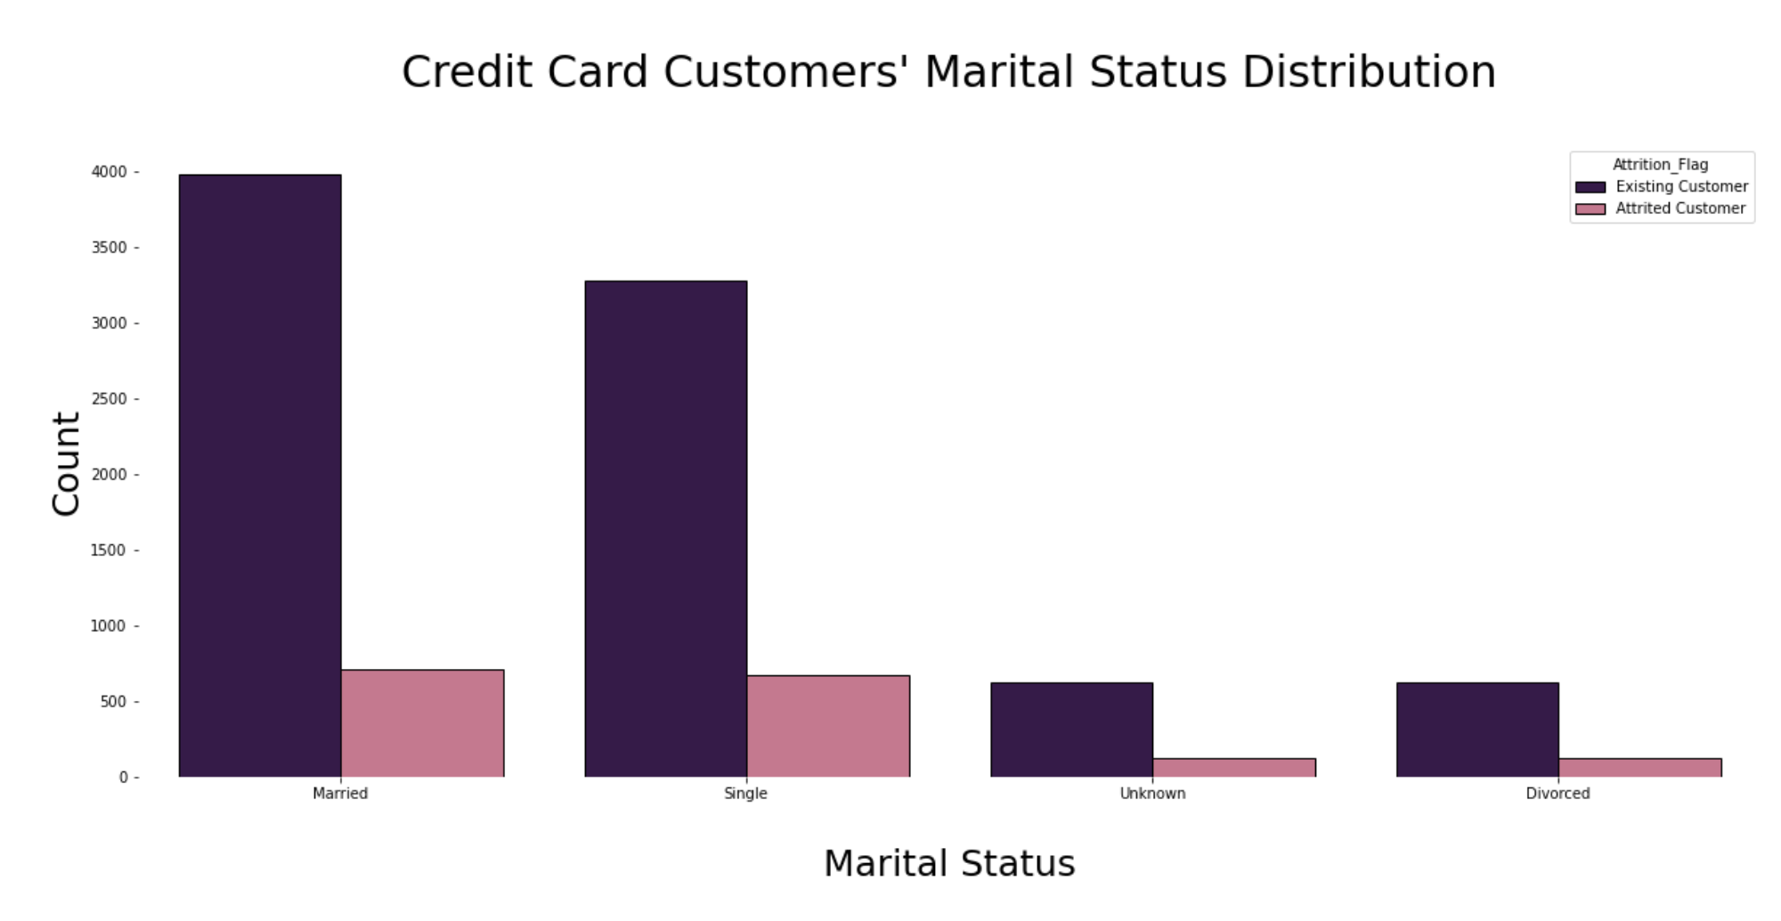
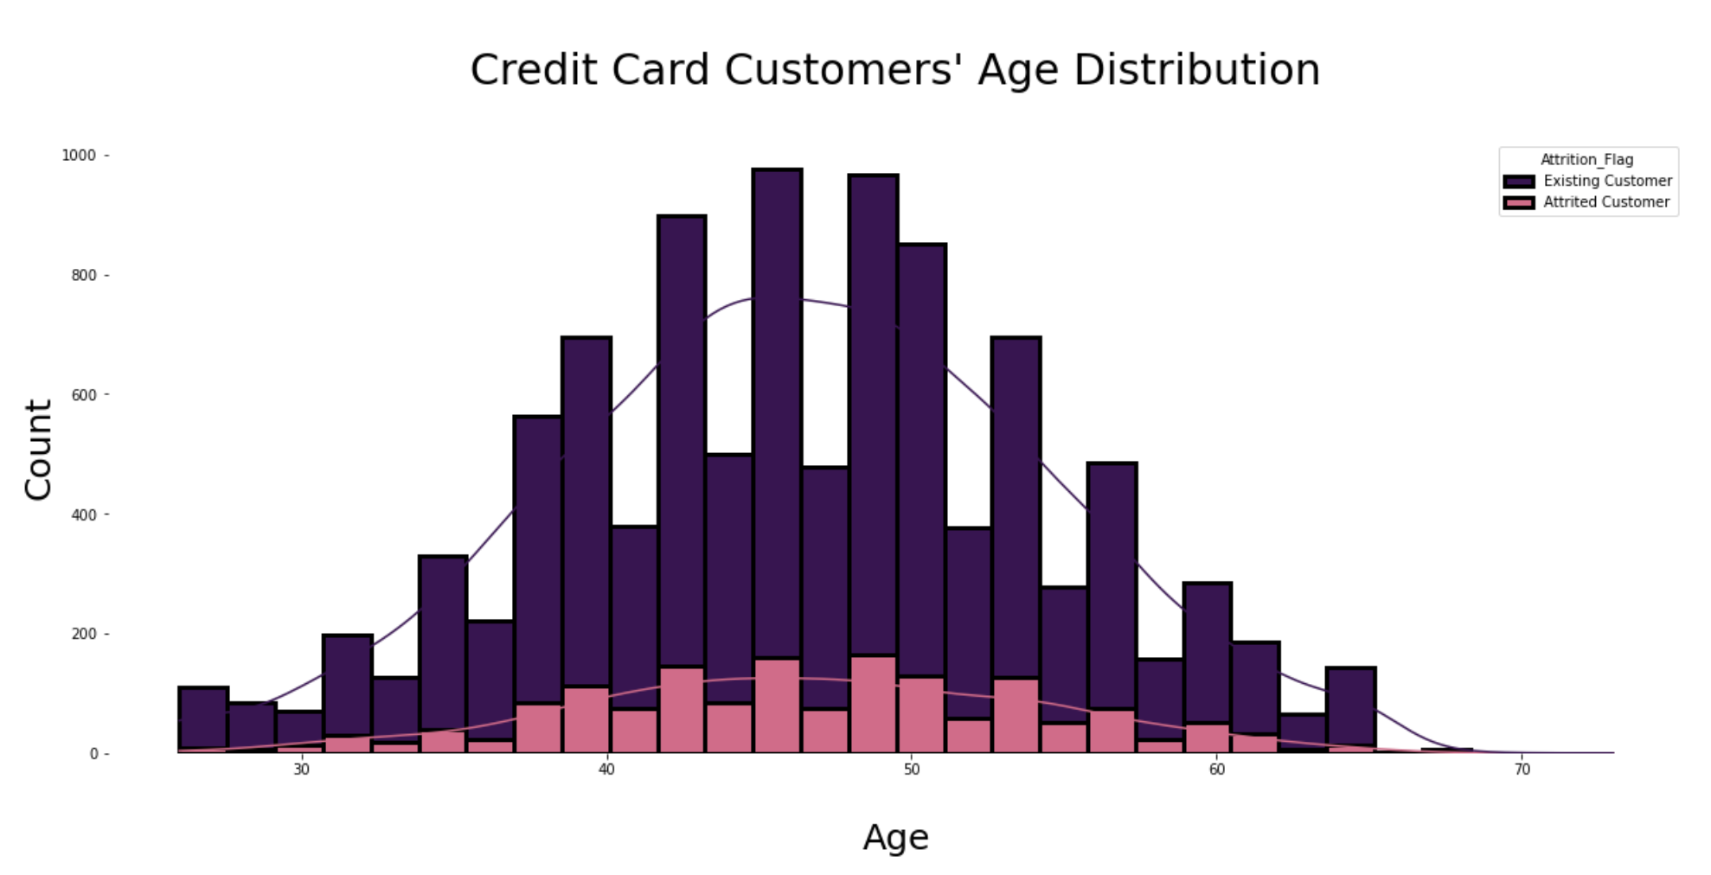
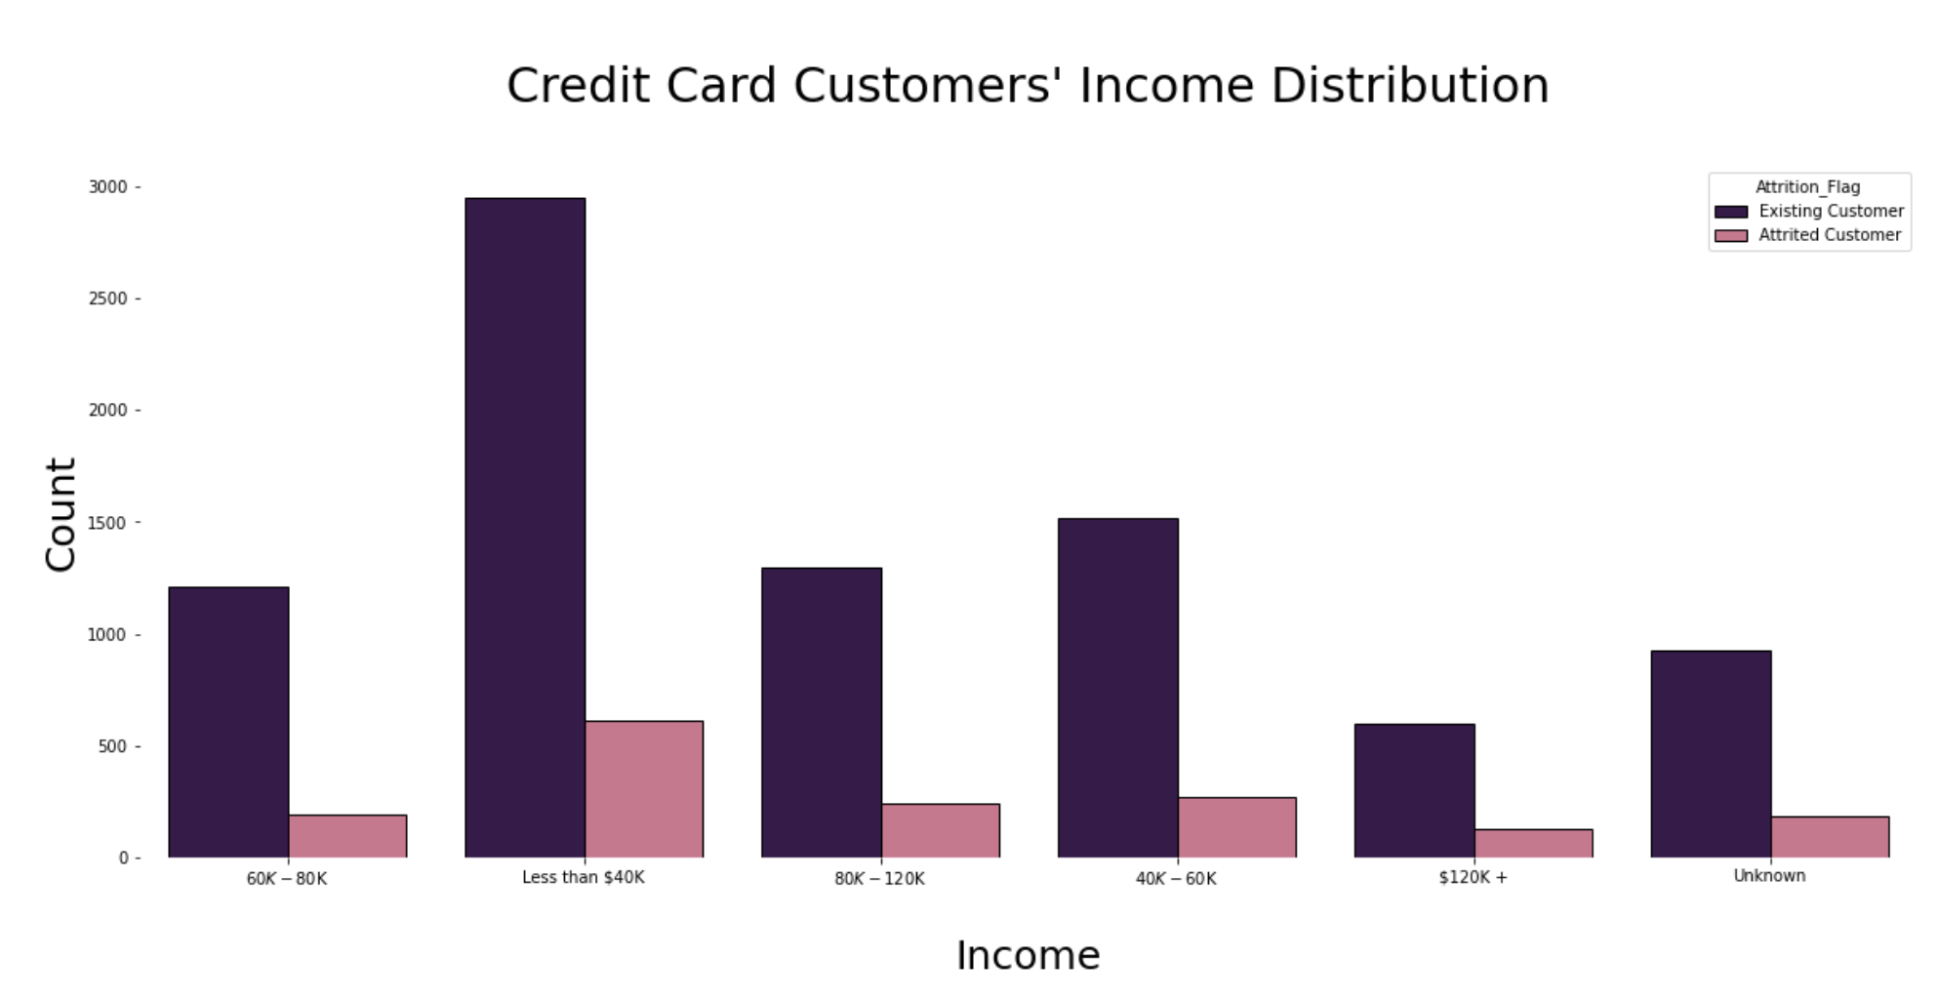
Histograms & Plots
Majority of the credit card customers have a Graduate Education Level.
Majority of the credit card customers are Married.
Majority of the credit card customers have an income that is less than $40k.
For Age distribution, most of the customers fall between 35 to about ~55 years old.

Slide 13
Feature Selection
Using the findings from the Correlation Map,
Features will be dropped/removed.

Slide 14
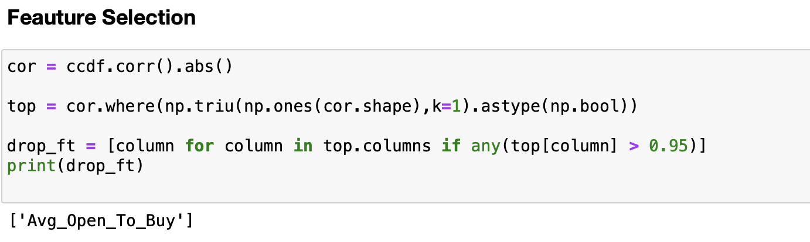
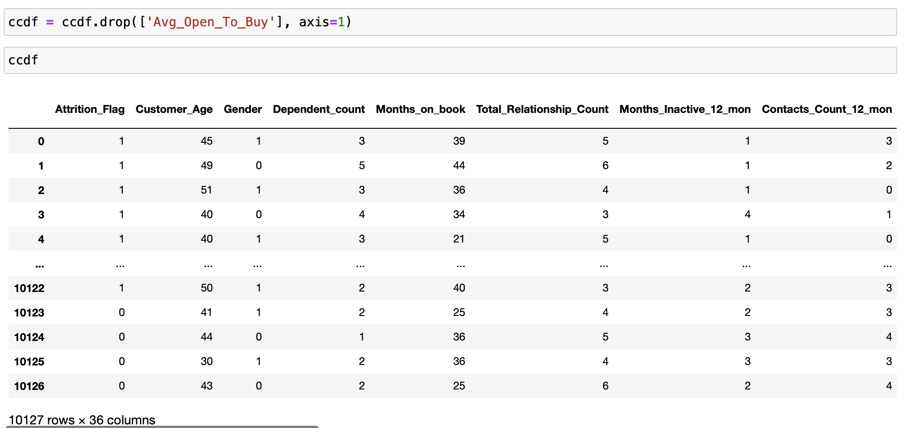
Feature Selection
The columns that have an absolute correlation value greater than 0.95 are added to a list named drop features
Only one feature meets this threshold: “Avg_Open_To_Buy”
Feature is dropped from Dataset and new dimensions are 10,127 rows and now 36 columns.

Slide 15
Model Evaluation
Dataset is split into Training and Testing sets to evaluate its accuracy and prediction measures as well.

Slide 16

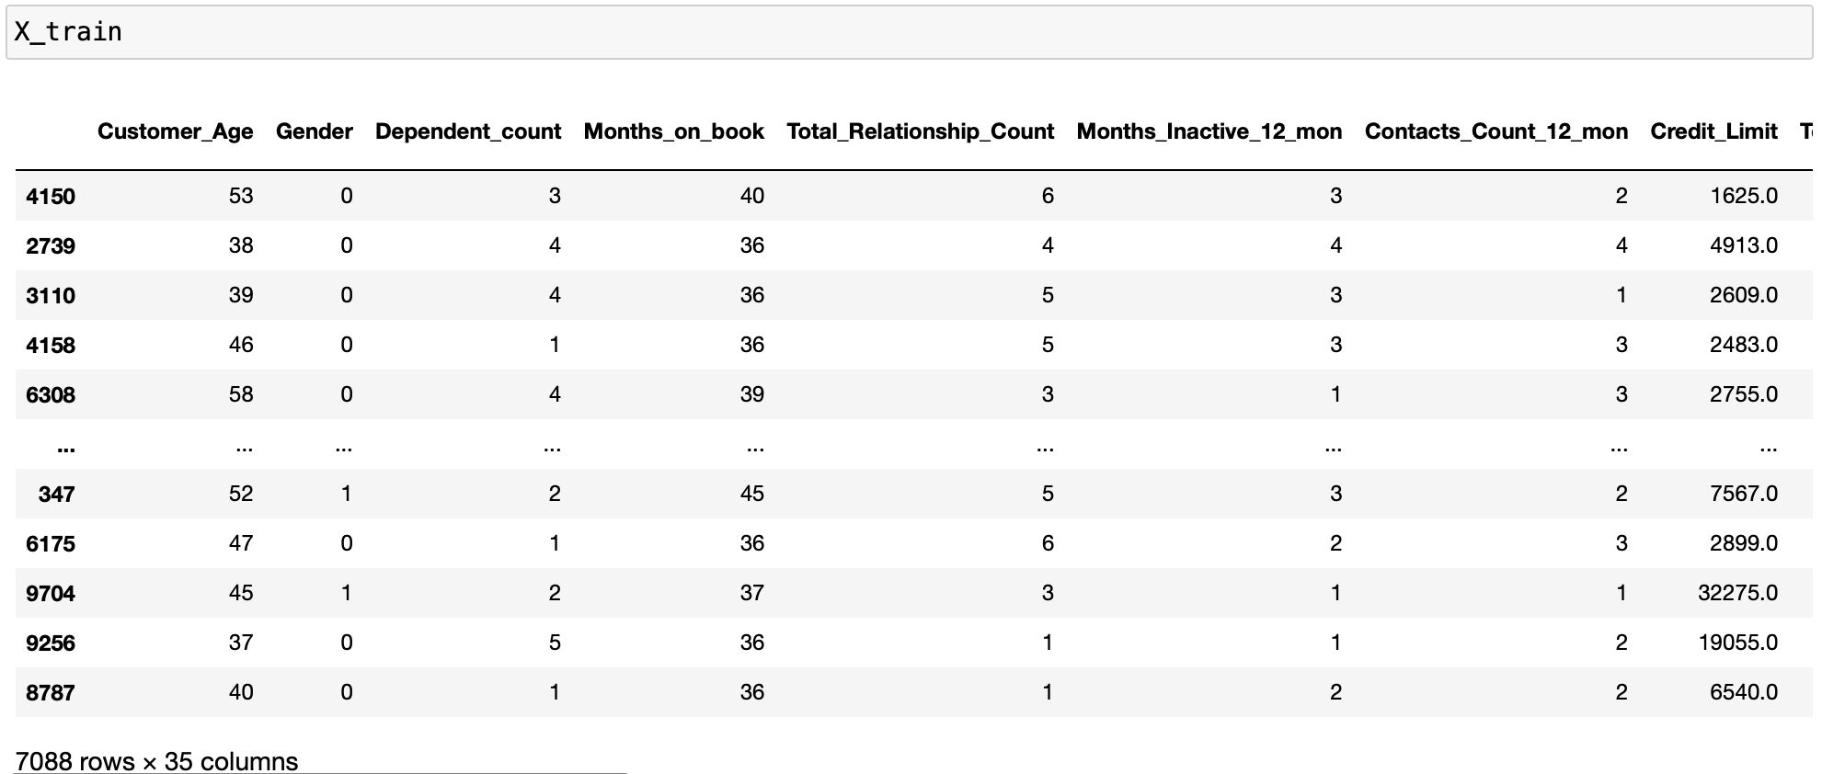
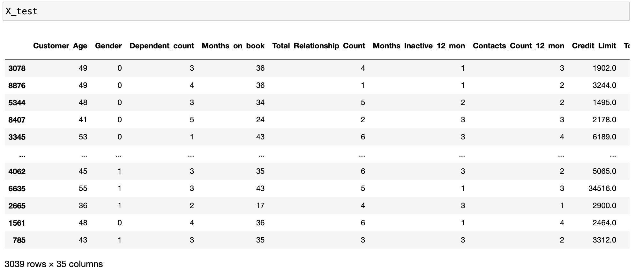
X_train
In the future
X_test

Slide 17
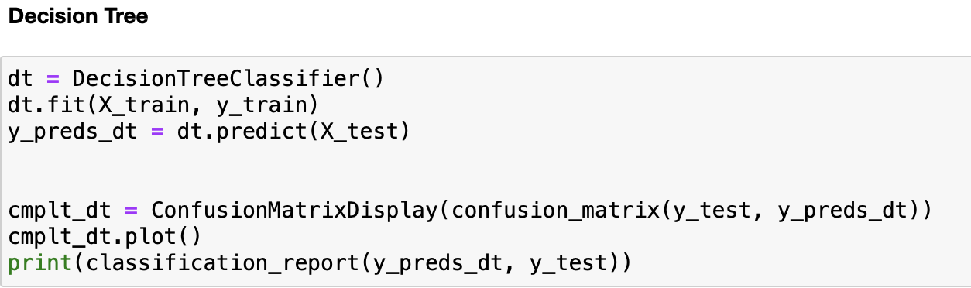
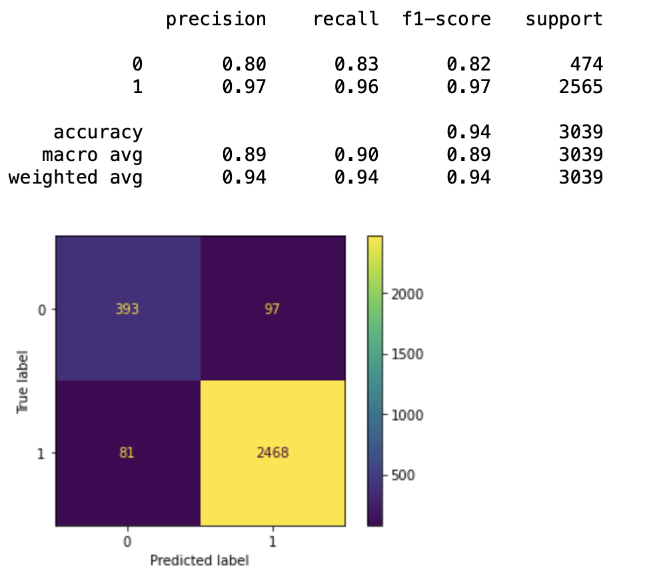
Decision Tree
Model Accuracy is 94% with a Precision of 80% and Recall of 83%.
When a customer is predicted to churn it is correct 80% of the time.
The Decision Tree classifier correctly identifies 83% of all churn customers.

Slide 18
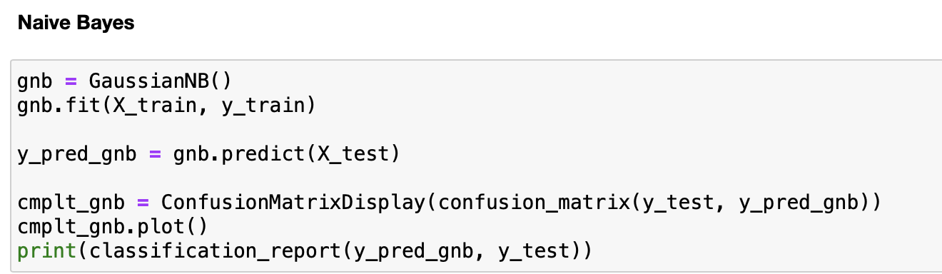
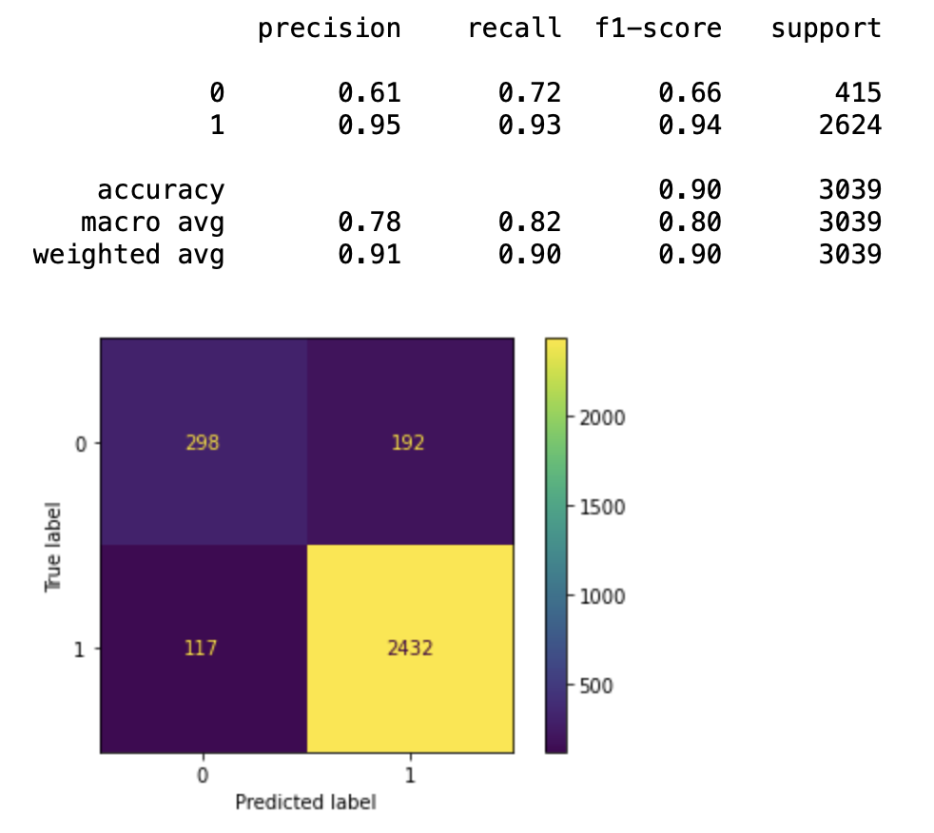
Gaussian Naïve Bayes
Model Accuracy is 90% with a Precision of 61% and Recall of 72%.
When a customer is predicted to churn it is correct 61% of the time.
The Gaussian Naïve Bayes classifier correctly identifies 72% of all churn customers.

Slide 19
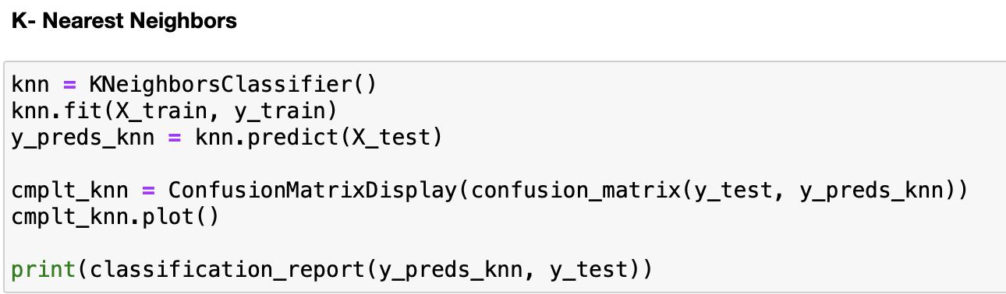
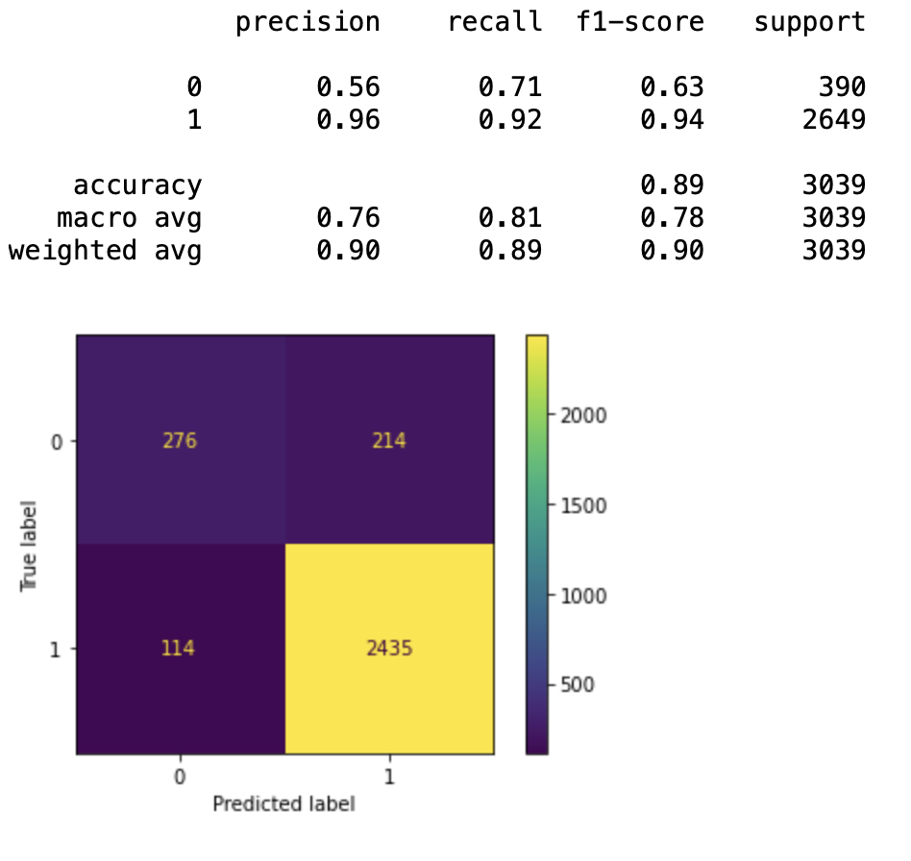
K-Nearest Neighbors
Model Accuracy is 89% with a Precision of 56% and Recall of 71%.
When a customer is predicted to churn it is correct 56% of the time.
The K-Nearest Neighbors classifier correctly identifies 71% of all churn customers.

Slide 20
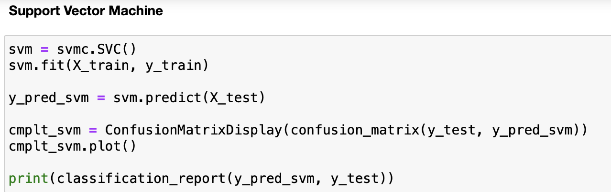
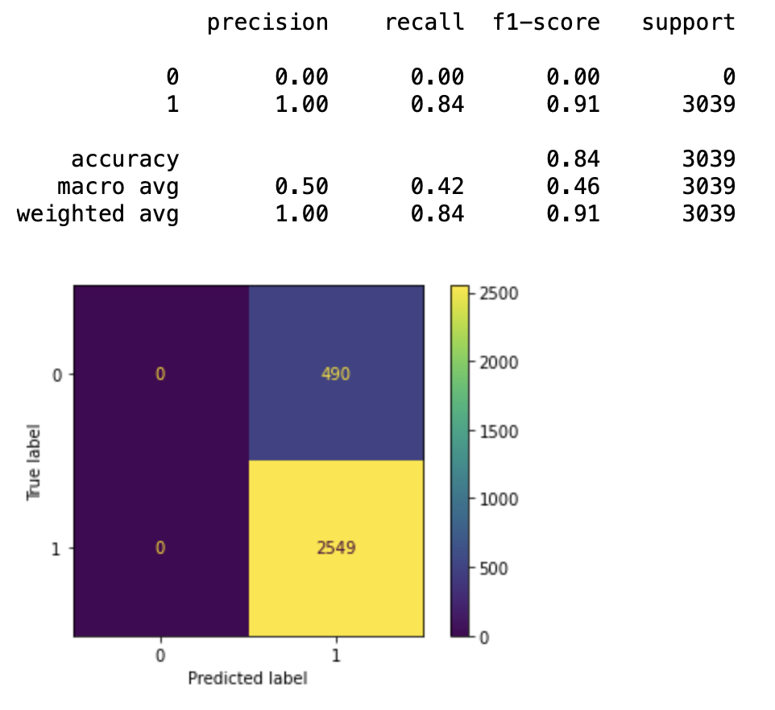
Support Vector Machine
Model Accuracy is 84% with a Precision of 0% and Recall of 0%.
When a customer is predicted to churn it is correct 0% of the time.
The Support Vector Machine classifier correctly identifies 0% of all churn customers.

Slide 21
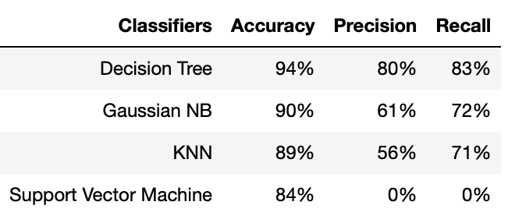
Final Results
Decision Tree performed the best with an accuracy score of 94%. Gaussian Naïve Bayes followed with an accuracy score of 90% and KNN with an accuracy score of 89%. Support Vector Machine performed the poorest out of the four classifiers with an accuracy of 84%.

Slide 22
Conclusion/Modifications
Overall, dataset was properly cleaned and prepared for model evaluation.
Conducted 4 supervised learning classifiers on dataset and computed 4 accuracy, precision and recall scores.
Since the dataset only consisted of 16.1% of customers who churned, it was difficult to train the model to predict churn customers. This is why we saw low Precision and Recall scores for the churn customers.
Decision Tree and Gaussian Naïve Bayes produced the higher accuracy scores. Although SVM is much faster in computation time than KNN, its precision and recall scores are not positive indications of a good model for predicting churn customers.
If computation time is an important factor the Naïve Bayes followed by Decision Tree classifier are better options because they are much faster than SVM and KNN.

Slide 23
Improvements/Future Works
To improve model Precision and Recall scores for identifying churn customers, data for churn customers could be unsampled.
The data gathered can be used by those in the banking industry to see what features are important to consider i.e. Income, Education Level, Credit Limit, etc. when dealing with customer attrition.
Data explored can be used by many banking managers looking to tackle and help prevent customers from leaving their credit card services. The EDA findings would allow them to draw conclusions as to who they should target for preventative measures and offer better services i.e. gender, age, marital status, etc.

Slide 24
Thank You!

